Slide 1





Introduction to University of Exeter Business School Programmes

Slide 2
Key Information:
All our undergraduate degree programmes are made up of modules. This will be a mix of modules you have to take and some you choose:
Compulsory modules – modules you MUST take
Optional modules – modules that you choose
15 credit modules usually run for one term.
30 credit modules usually run in both Term 1 and Term 2.
All undergraduate students must take 120 credits worth of modules each year.

Slide 3
Programme Structures
The programme structure for your chosen course will be listed on this page: INTO students | University of Exeter Business School |
Your programme structure will tell you what the compulsory modules are for your programme and if you have to pass any of them to continue to the next year of your course.
Condonable - if a module is condonable, it means that if you fail it, but fail no more than 30 credits worth of condonable modules and have an average for the year of 40%+ you can still progress to the next academic stage.
Non-condonable – a module that you MUST pass.

Slide 4
Understanding Module Codes
Module codes show you:
Which college runs the module
BE = Business School
BUS = Business School, (With Industrial experience or Dissertation)
Which department runs the module
BEA= Accounting
BEE= Economics
BEM= Management
What level the module is
BEA1= Level 1 (First Year)
BEE2= Level 2 (Second Year)
BEM3= Level 3 (Third Year)

Slide 5
Module Selection
Transitioning from these programmes:
International Year One Management and Business Economics
International Year One Accounting and Finance
If you are on one of the above INTO programmes you will need to complete the INTO Online Module Selection form which can be found on our website: INTO students | University of Exeter Business School
When you click on the form it should look like this:
INTO Optional Module Selection 2026-2027 (Preview)
Things to remember:
Module spaces are allocated on a first come first served basis
Please ensure you select the correct programme you will be joining
If you are unsure which programme you are joining, please speak to Isaure

Slide 6
Module Selection for Integrated Programmes
Integrated programmes at ISC:
BSc Accounting and Finance with International Year One
BSc Accounting and Business with International Year One
BSc Business Economics with International Year One
BSc Business Management with International Year One
BSc Marketing and Management with International Year One
If you are on one of the integrated programmes above, you will not need to complete the INTO module selection form. Instead, you will need to complete Online Module Selection (OMS) in SRS (Student Records System) which will open from Monday 23rd March 2026 and will close at 5pm on Friday 27th March 2026.
For guidance and instructions on how to select your modules please see this link: Online module selection | Student hubs | University of Exeter

Slide 7
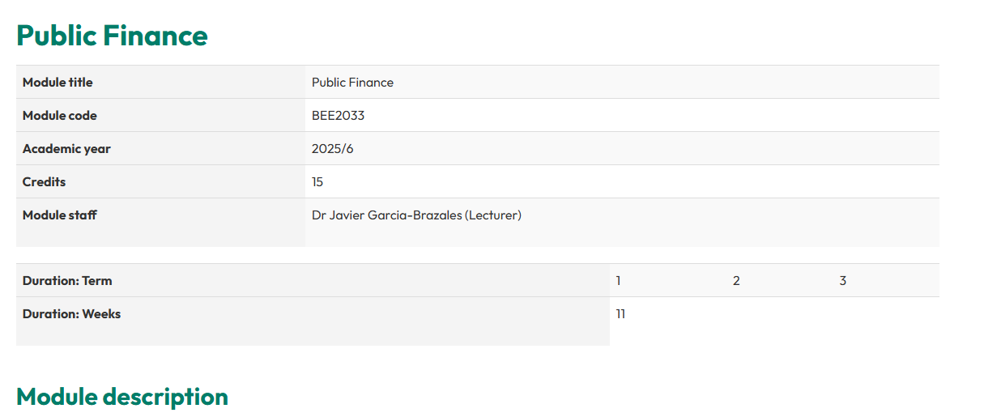
Module descriptors and information
Further information about modules can be found the module descriptors, which will include:
Module content
Which Term the module is taught in (Term 1, 2 or 1+2)
The Module Lead
Assessment Breakdown
Module rules (pre-requisites, co-requisites, non-requisites)
Example: BEE2033 | University of Exeter

Slide 8
Understanding module rules
Pre-requisites - modules that you must have taken before you take this module
Co-requisites - modules that you must be taking at the same time as you are taking this module
Non-requisites - modules that you cannot take both of

Slide 9
Things to think about when choosing..
The number of credits you are taking each term: We highly encourage all students to spread their modules evenly across both terms e.g. 60 credits in Term 1 and 60 credits in Term 2. You can choose to do an uneven split such as 45 credits in one term and 75 credits in the other, but this will mean more workload in one term.
You can change your modules later: If your plans change, you can change your modules in September at the start of term. This is called Module Change. Please note, modules may not have spaces available in module change.
Level 1 Modules: You can take up to 30 credits from Level 1. Some programmes already have Level 1 Compulsory modules, if you do, you may not be able to select any more. You can only select these modules in module change in September.
Professional Bodies Exemptions: Accounting Students please ensure you check out the accredited modules, these modules provide exemptions for professional bodies.

Slide 10
Things to think about when choosing..
Modularity: You may take up to 30 credits each year outside of the Business School. If you are interested in taking a module from outside your course or programme of study, you should first discuss this with the College who runs the module.
Proficiencies in a language: You might wish to study a new language as part of your course here. If you pass 60 credits of language modules (from one of the proficiency options) you will be entitled to add the words 'with proficiency in' to your degree title when you graduate. Details here: Languages | Minors: Future Skills Pathways | University of Exeter
Minors: You might be interested in studying a minor subject. This involves taking 30 credits in year 2 and 30 credits in year 3 from a minor subject. The minors available are detailed here: Minors: Future Skills Pathways | University of Exeter

Slide 11
Help & support
Please check your current programme carefully to see if you are an integrated student or an INTO progressing student to figure out which module selection form you need to complete.
If you would like some advice or support around modules and or module selection we are here to help.
In Person: Monday to Friday 9.00am-5.00pm at the Building One Information Point
Email: info.buildingone@exeter.ac.uk
Telephone: +44 (0) 1392 722660
Notes:
.

Slide 12
Help & support
In March we will be holding in person sessions at the Building One Information Point on Wednesdays 10.00am-12.00pm and 2:00pm – 4:00pm
Email: info.buildingone@exeter.ac.uk
Telephone: +44 (0) 1392 722660
Notes:
.

