Slide 1
BEMM212DA
Innovation and Risk mitigation – Cyber Security
Nirosha Holton

Slide 2
A bit of history
COMPUTER SECURITY - Concepts, techniques, technical measures, and administrative measures used to protect information assets from deliberate or inadvertent unauthorized acquisition, damage, disclosure, manipulation, modification, loss, or use (IBM Dictionary of Computing, 1994).
INFORMATION SECURITY - Protection of information from a wide range of threats in order to ensure business continuity, minimize business risk, and maximize return on investments and business opportunities (ISO/IEC 17799 Code of practice for information security management, 2005).
“There are a number of terms currently being used by security practitioners that really annoy me, such as ‘threat vector’ and ‘threat landscape’. The worst among these is ‘cybersecurity’. What a wonderful word. Its real beauty is that it means whatever you want it to. It is now shortened to ‘cyber’ and is used and misused across the world by serious professionals, semi-literate journalists, snake-oil merchants and associated charlatans alike.”
- Gregor Campbell, information security consultant,
www.infosecurity-magazine.com/opinions/comment- cybersecurity-and-reality-whats-in-a-word/, May 2013

Slide 3
What is cyber security?
Definition of Cyber Security
Notes:
2mnts breakout

Slide 4
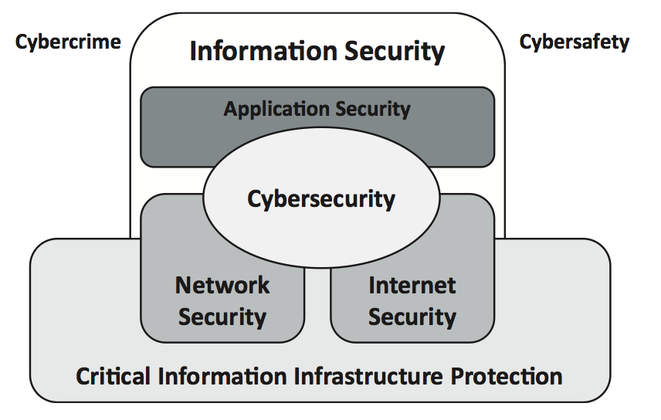
Possible Overview
ISO27032 – Guidelines for Cyber Security, July 2012
Notes:
How is this relates to Innovation?

Slide 5
How does cyber security affect Businesses and Users?
Ever increasing dependency on Digital Technology
Emerging New Threats & Risks
Lack of User Awareness & Basic Protection
So, what does it mean to the leadership positions?

Slide 6
Digital society
Increased dependency on Systems
Increased number of Devices per person
Digitally driven, Global Market
Emerging New Threats & Risks
Lack of user awareness & basic protection
Widening Skills Gap
Notes:
Global Economy Facilitated by Digital Technologies;
Data Driven business decisions -
Rollout of DFS in emerging markets has seen over 515 million adults gaining access to financial tools with account ownership rising by 51% (Global Findex Survey, 2017), which indicates expansion of markets, financial inclusion, economic growth and global development.
Ethical and Sustainable Development Goals (Inclusive Digital Financial Services)
- Upward trajectory of financial inclusion can be attributed to the embracing of digital technologies including digital payments, government policies and a new generation accessing financial services through mobile phones and the Internet.
Emerging Markets for Products and Services
Among others, this means social and economic empowering through increased income potential (especially for those in poorer countries), managing financial risks, direct access to global markets, lower the costs of receiving payments, increase savings, education, social services, reduce corruption and improve efficiency.
https://openknowledge.worldbank.org/bitstream/handle/10986/29510/211259ov.pdf

Slide 7
Importance of cyber security
Three-quarters of businesses (95% medium and 93% larger businesses) and seven in ten charities say that cyber security is a high priority for directors and senior management.
Increase in large businesses seeking cyber security information or guidance
(Cyber Security Breaches Survey, 2021)

Slide 8
Challenges to Cyber Security
What are the ways in which that digital growth can impact your organisation?- 10mnt group discussion
Things to consider,
Poor Understanding of risks
Lack of Digital literacy
Lack of Trust
Governance
Number of Devices owned by individuals (IoT & BYOD)
Social and Professional Networking
Cloud Computing
Infrastructure and budget
Notes:
Positive and negative impacts

Slide 9
Severity of the challenges
Phishing
Fraud
550m Phishing emails sent out by a single campaign
50% English local authorities relying on legacy software
1,464 Number of Government officials using “Password123” as their password in the US
Number 1 worst password used consecutively since 2015
6.4b Fake emails sent worldwide – EVERY DAY!
4.7m Job openings and increasing, but shortage of skilled workers
Internet of Things (IoT)
Spam
Scams
Identity Theft
Data Espionage
Data Leakages
Social Engineering
Malware
Insider Threats
Financial and Reputational Loss
Ransomware
Viruses/worms/trojans/APT/RATS
Notes:
Number 1 worst password – 123456 what is the second worst? 12345678! Everything leads to human interactions with digital technologies.

Slide 10
Understanding the Prevailing Issues
Connected world we live in…
Digital Devices are an implicit part of all of us and technology has changed how we work, live and interact with each other socially and professionally
Responsibilities…
Whilst technologies enhance our lives, the risks and threats are also well noted and have become the responsibility of ‘everyone’
Lots of information and technology are provided to enhance security
And yet, the prevailing issues indicate that the current attempts are not successful..
Notes:
Most of the dots are connected to human interactions. Does that make humans the weakest link?

Slide 11
Possible solutions?
(5mnt Discussion on possible solutions to mitigate risks)
Network monitoring tools
Automation?
AI?
If these are solutions, why do we have a persisting problems?

Slide 12
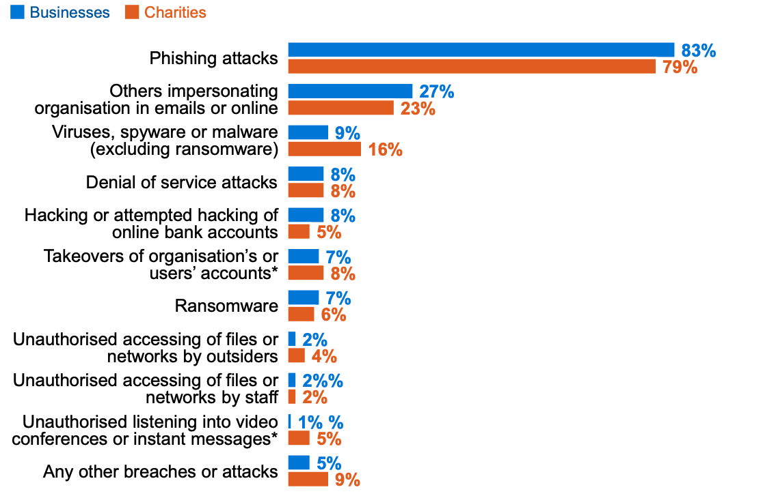
Weakest Link?
Types of Attacks (Cyber Security Breaches Survey, 2021)
Human interactions are fundamentally intertwined with systems and cannot be avoided altogether
Current efforts are often ineffective: technology is provided, but the overall success depends on the behaviour of end-users
Notes:
Maybe the humans are the weakest link, but…
With everyone using at least one digital device these days, digital technologies have become a lifestyle as opposed to being a mere tool.
There is no doubt that there are benefits to using these technologies (and this is certainly highlighted in the current pandemic where we are expected to work from our homes and not encourage to mingle with others and thus becoming a part of all of us and especially a lifeline for those most vulnerable amongst us to not only interact with others, but also survive)
That being said, it is well known that there are increased risks and there is a need to protect them as well as the users.
Owing to this awareness, and there seems to be plenty of information out there to support end users to avoid falling victim to cyber threats. We also know that threats are continuing to increase! And given the majority of these incidents are attributed to end user interactions, it is also well noted that end users are blamed for not being able to avoid falling into scams and other threats. So it is worth analysing a little more to understand what the actual issue is.
So, it is worth looking at if the end user expectations are reasonable….

Slide 13
Increased efforts?
Organisational attitudes are taking a positive turn towards user awareness and education (DCMS, 2020)
National Cyber security Strategy - Increased government-wide campaigns introduced to improve overall cyber resilience (NCSC, 2016)
Cyber Aware
Get Safe Online
10 Steps to Cyber Security
Cyber Essentials
And yet, with majority of attacks linked to human interactions, only 9% of businesses considered having a formal user education and awareness policy and carry out cyber security training for staff (Cyber Security Breaches Survey, 2021)
Cyber Security Breaches Survey 2016 – 2020
Notes:
Evidence indicate that the efforts to increase end user awareness and training is increasing and certainly we can see some of the efforts across many nations. For example, under the 2016 Cyber Security Strategy, UK government attempts to tackle this issue in two ways. first by organisational wide campaigns like CE and 10 Steps to cyber security whilst targeting end users directly with campaigns such as Cyber Aware. And similar attempts can be seen across many other countries as well.
So, what is the issue then? Plenty of information and guidance is seemingly provided and yet users fail to adopt them and there must be a reason for it.
Given the increased efforts, it is reasonable to expect that organisations to adopt these schemes. However, as you can see in the this slide, looking at the Cyber Security Breaches survey since 2016 until 2020, it is still evident that, with the exception of 2019, (perhaps due to the increased expectations of GDPR in 2018 ) User Education and Awareness still plateaus between 28% and 30%.

Slide 14
End-Users Security Skillset & Knowledge Framework
Core Concepts – Backups, Authentication, Patches & Updates, Anti-malware, Firewalls, Encryption, Data Security, Incident Management, Disaster Recovery
Online Security
Threats and Scams
Network Security
Storage
Communications & Messaging
Device Security
Application Security
(Furnell & Holton, 2020)

Slide 15
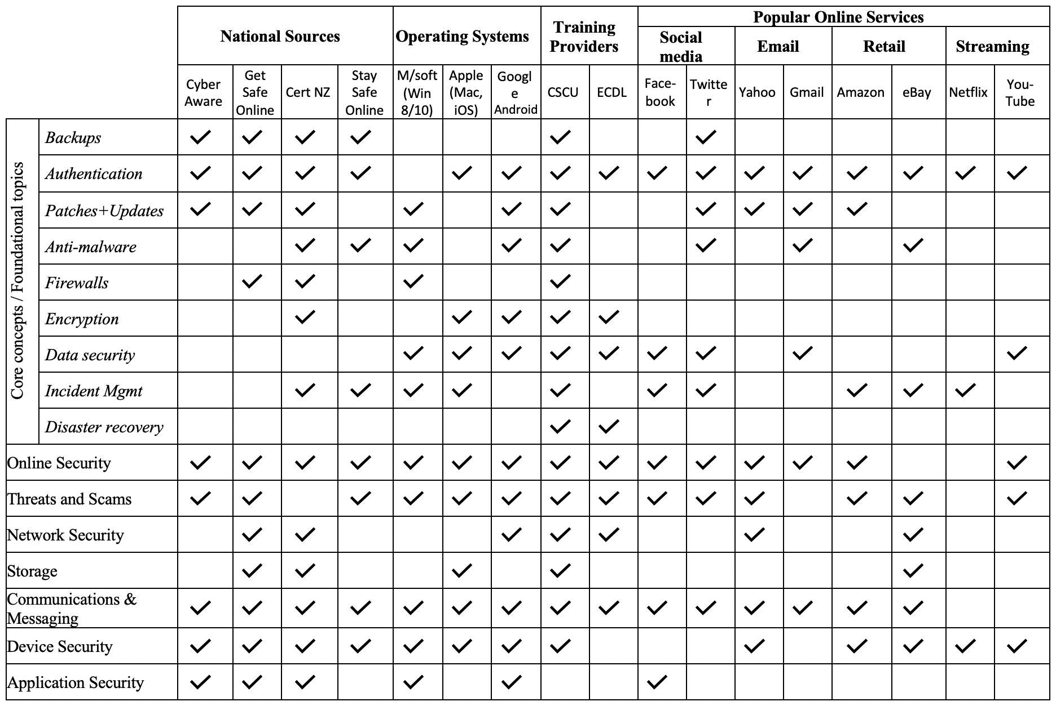
What does the guidance say?

Slide 16
What now?
Key Takeaways
Look at the Framework and understand the requirements
Compare how does your organisation promote end-user cyber security awareness?
Think of ways you can improve end-user awareness within your organisations
Assess your approaches regularly
Cyber Security is not just an IT problem – it is everyone’s responsibility

Slide 17
Some Useful Reading
N. Holton and S. Furnell, "Assessing the provision of public-facing cybersecurity guidance for end-users," 2020 IEEE 6th International Conference on Collaboration and Internet Computing (CIC), 2020, pp. 161-168.
Cyber Security Breaches Survey 2021 - https://assets.publishing.service.gov.uk/government/uploads/system/uploads/attachment_data/file/972399/Cyber_Security_Breaches_Survey_2021_Statistical_Release.pdf

