Slide 1

Introduction to Education Support & module choices

Slide 2
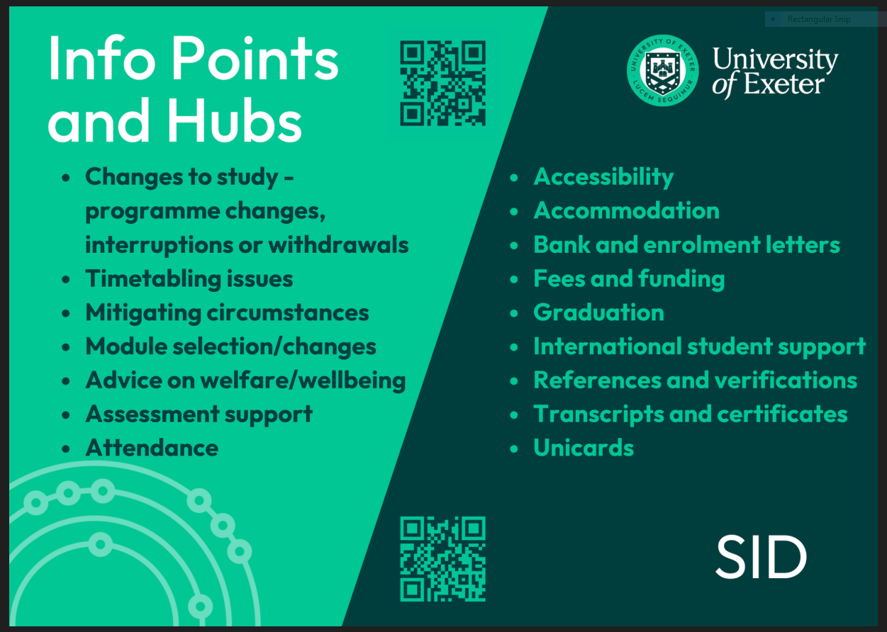

Info at Building One
Phone:
Tel: +44 (0) 1392 725269
Phone and Info Point opening times: 9.00am-5.00pm
Email: info.buildingone@exeter.ac.uk
We monitor this inbox Monday-Friday.
Welfare:
welfare.buildingone@exeter.ac.uk

Slide 3

Business School Website
Business School Website

Slide 4

Business School Website

Slide 5
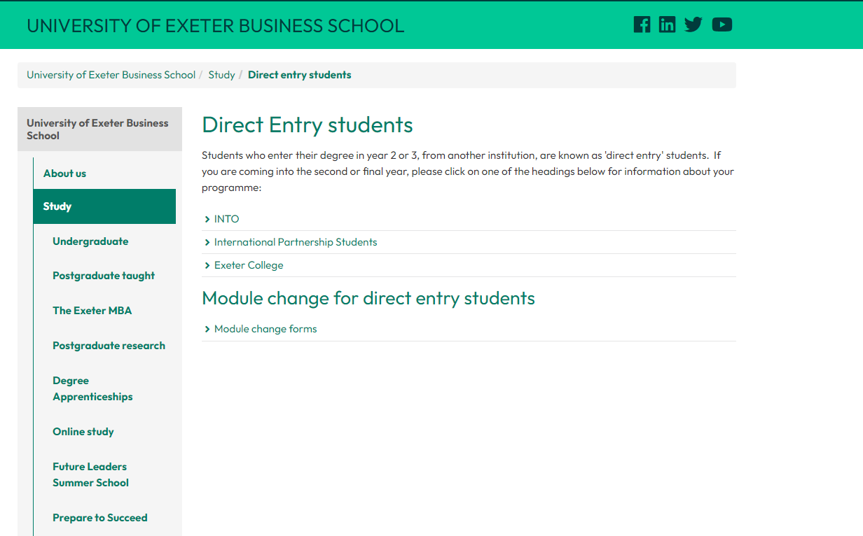
Business School Website

Slide 6
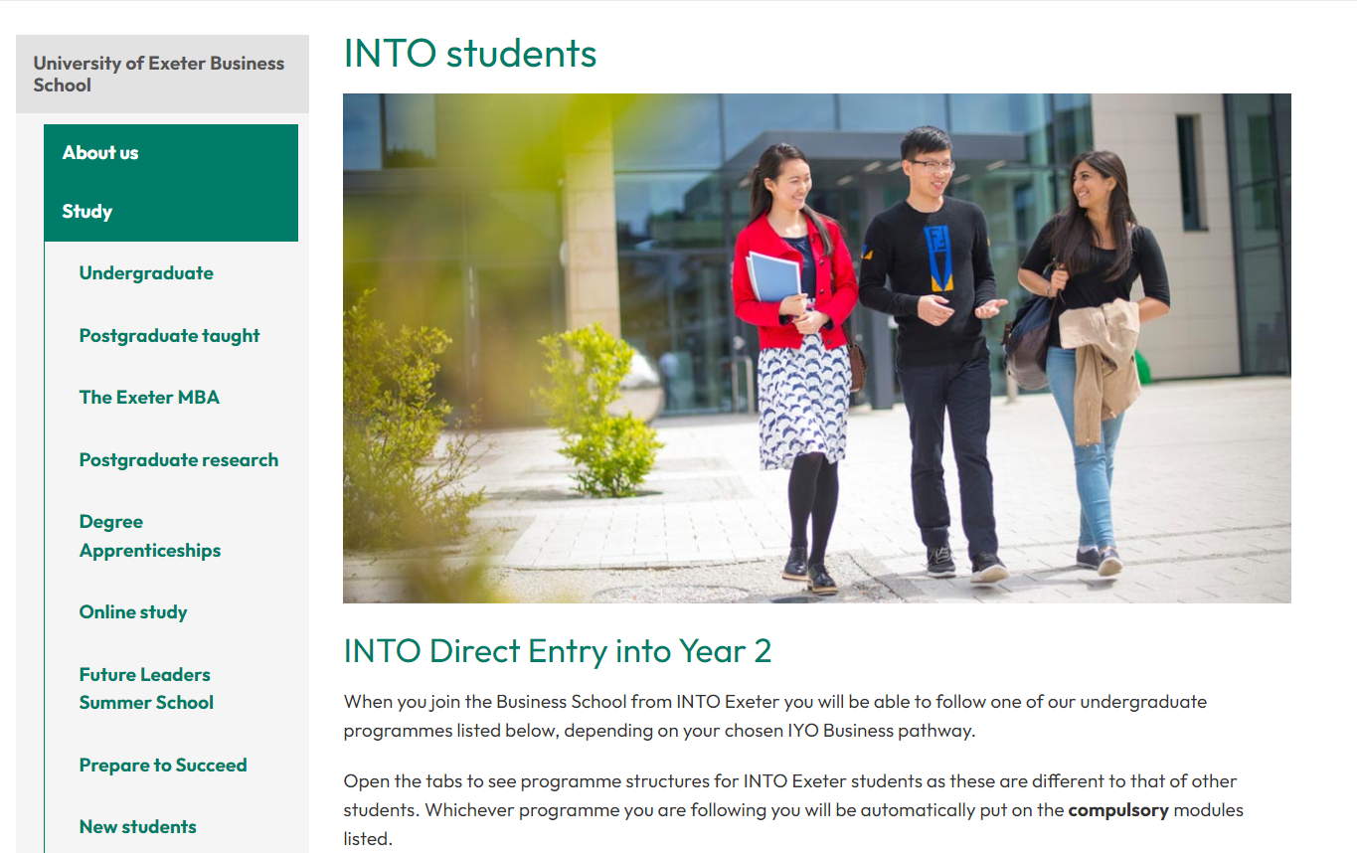
Business School Website

Slide 7
Key Module Information
All our undergraduate degree programmes are made up of a number of modules, each of which has a particular credit value, usually 15 or 30 credits.
  15 credits = a module that runs for a single term
  30 credits = a module that runs all year
Your modules must add up to the value of 120 credits in each year.

Slide 8
Glossary of Key Terms
It is important that you check all of the following when choosing your modules
Compulsory –modules you MUST take
Optional –modules you can choose
Module Requirements
Pre-requisites – modules that you must have previously taken to take this module
Co-requisites – modules that you must be taking while you are taking this module
Non-requisites – modules that you cannot have taken or be taking when taking this module
Programme Specific rules
Condonable - if a module is condonable it means that you can fail it and progress to the next level as long as you meet certain requirements.
Non-condonable – a module that you MUST pass.

Slide 9
Understanding Module Codes
Module codes show you:
Which college runs the module
BE = Business School
BUS = Business School, (With Industrial experience or Dissertation)
Which department runs the module
BEA= Accounting
BEE= Economics
BEF= Finance
BEM= Management
What level the module is
BEA1= Level 1 (First Year)
BEE2= Level 2 (Second Year)
BEM3= Level 3 (Third Year)
You can choose a module from any of these disciplines unless your Programme states otherwise!

Slide 10
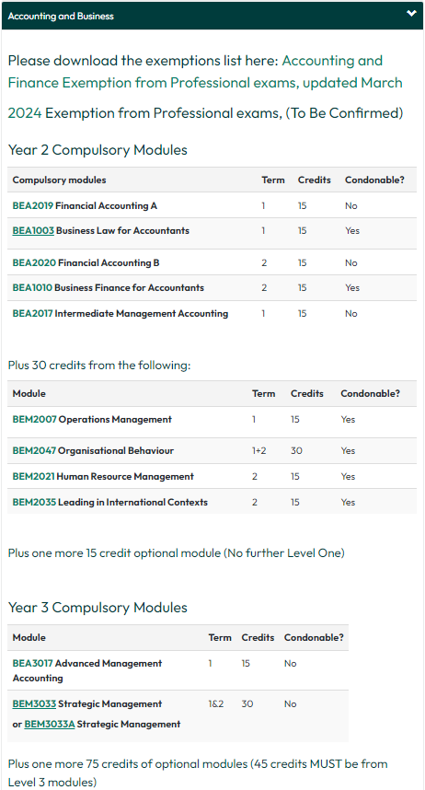
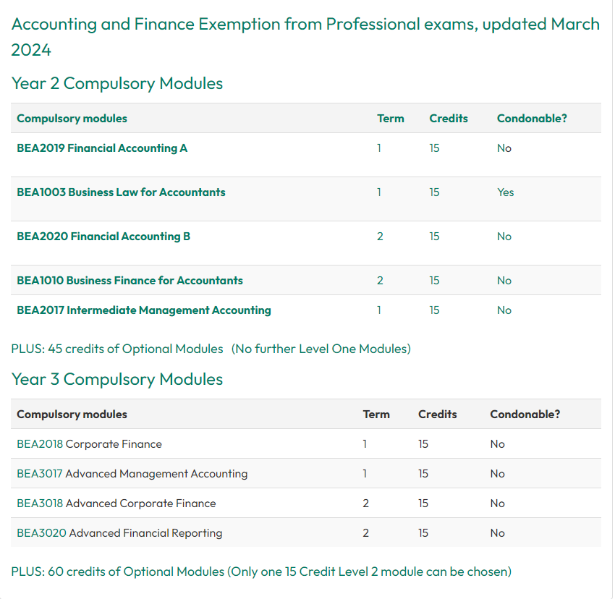
Compulsory Modules

Slide 11
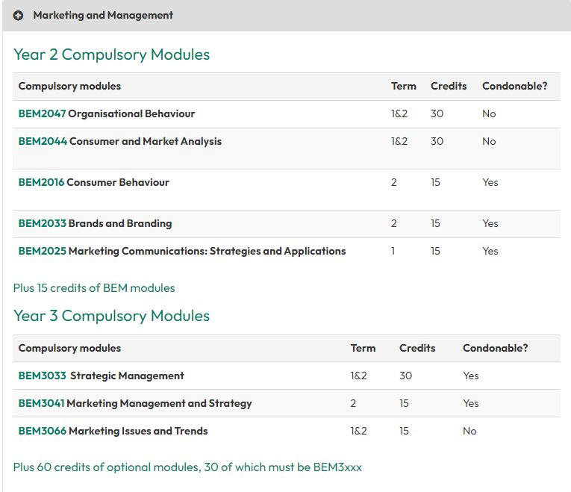
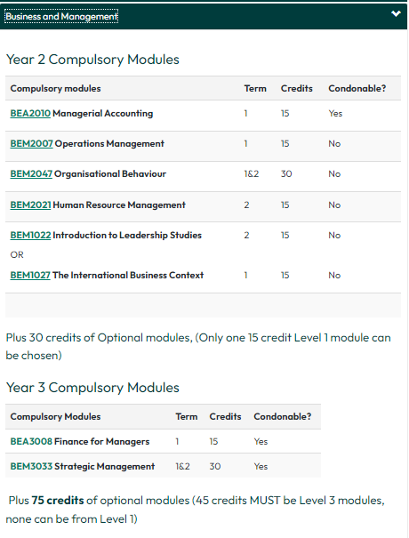
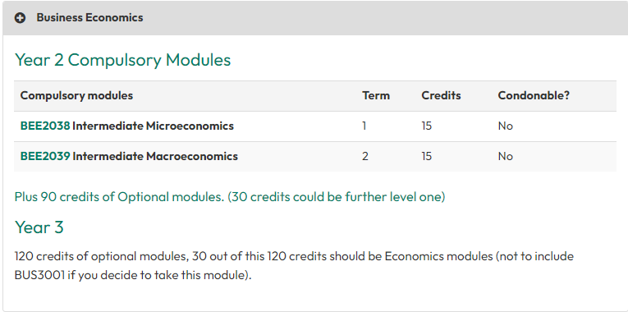
.
Compulsory Modules

Slide 12
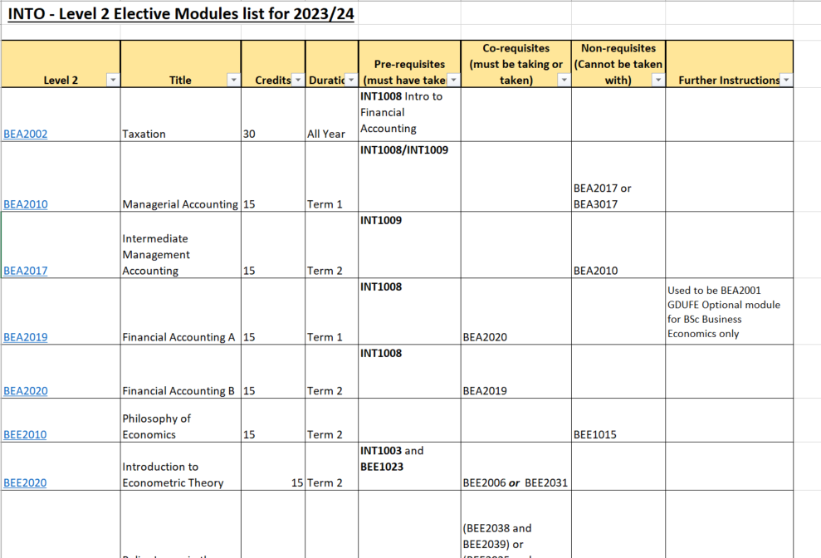
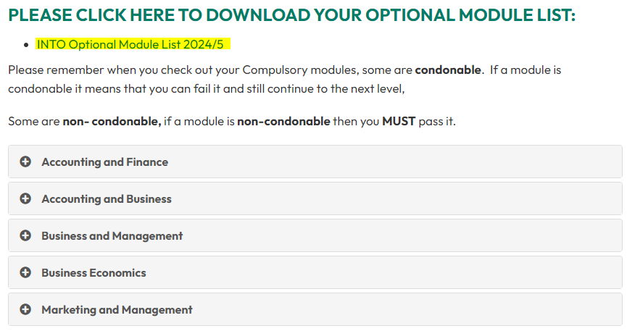
Optional Module Choice
Please download the Optional module list from which you can choose your optional modules from via the Direct Entry Page: INTO Optional Modules for 2024-25
You must select modules from your optional module list
You can find more in-depth module information via this link: http://business-school.exeter.ac.uk/study/undergraduate/modules/

Slide 13
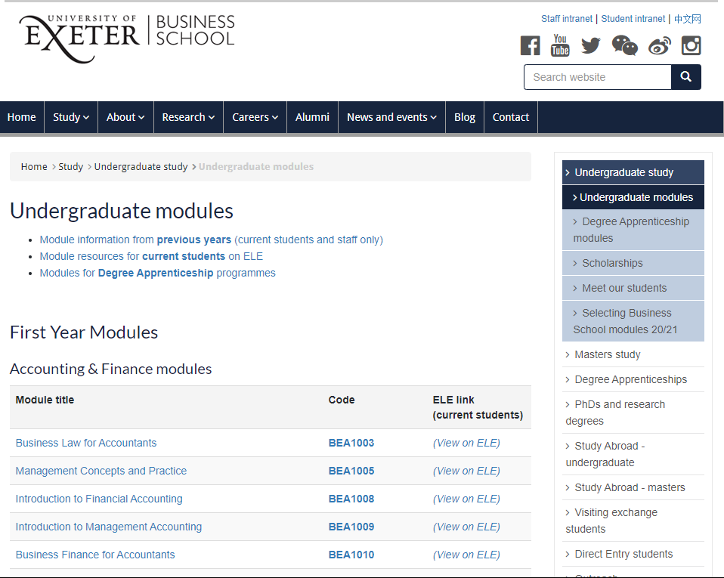
Optional Module Choice.
To find out more information on each module, click on the
module name or code, this will then bring up the module description.

Slide 14
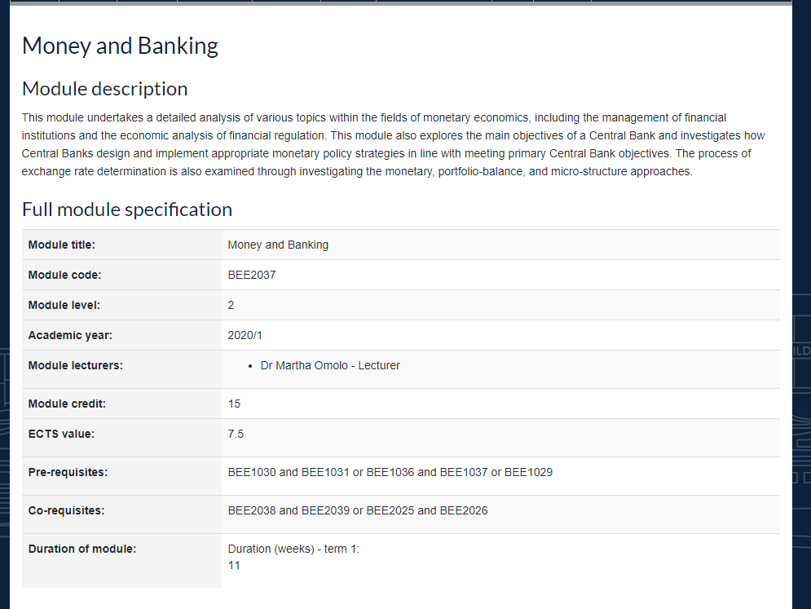
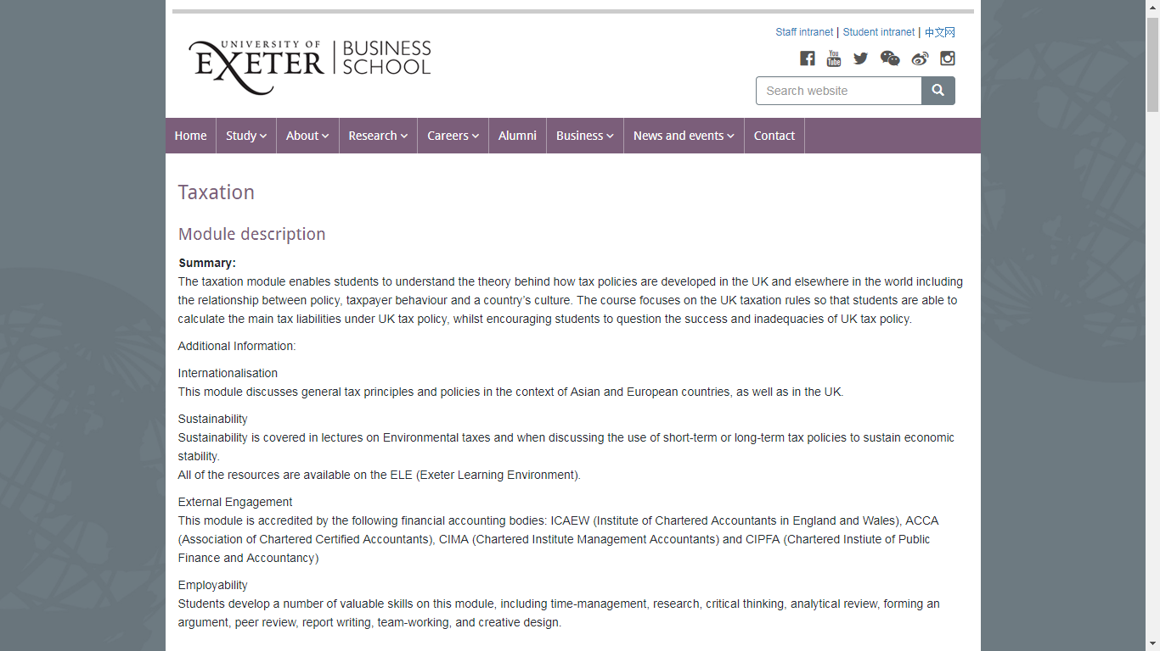
Business School Module Details

Slide 15
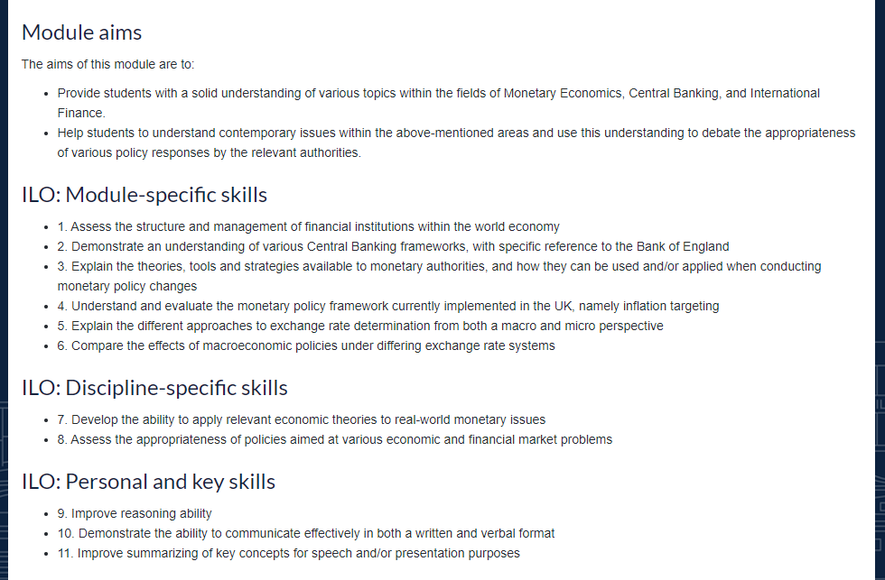
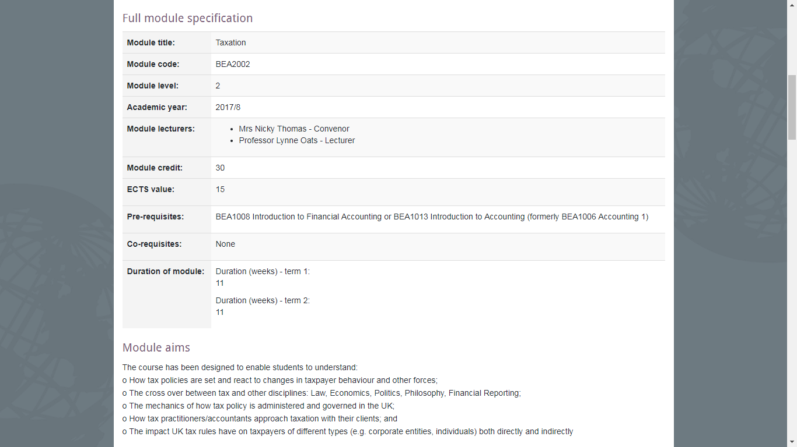
Business School Module Details

Slide 16
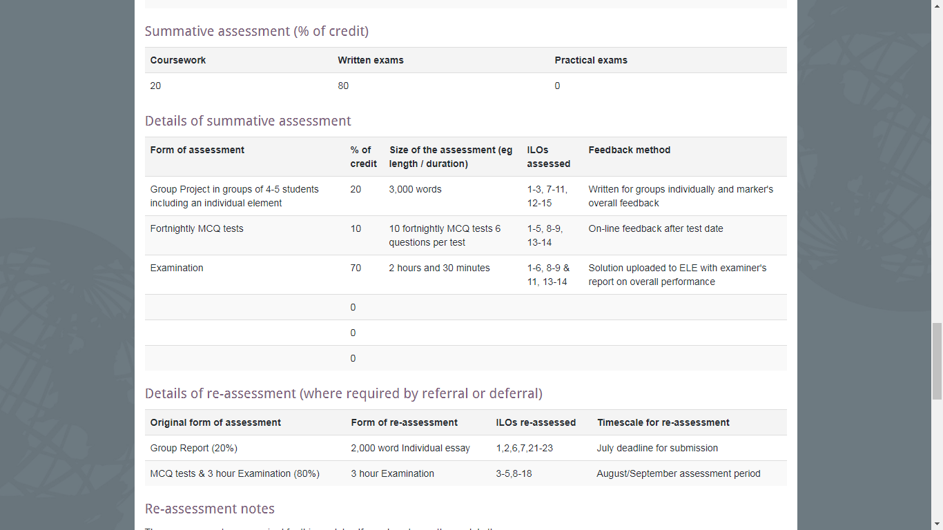
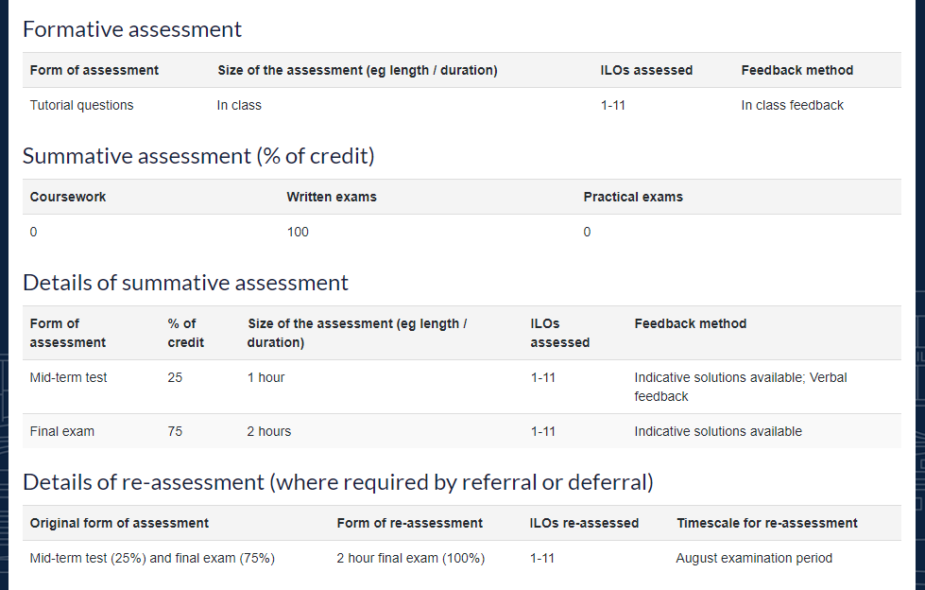
Business School Module Details

Slide 17
Optional Module Choice.
You cannot choose any credits from Level 1 at this point, you can only request to add them to your list when the optional module change form opens in September.
Accounting and Finance students and Accounting and Business students cannot choose any credits from Level 1. (You already have two Level 1 modules as compulsory modules.)
Sometimes it is possible to take up to 30 credits from another College, if your programme allows it (This will be opened up to you in September)
For example taking a Language
As you can only take up to 30 credits from Level 1, for some of your programmes you are not able to take a Level 1 Language module (these are usually 30 credits).
However some of the Programmes you take a Level 2 language module (French, German, Spanish or Italian).

Slide 18
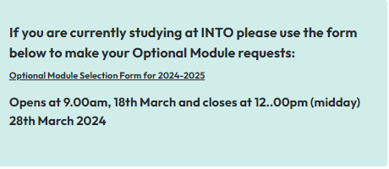
Business School Online Module Selection
The module selection form will be open from open from 9.00am (UK time) on Monday 18th March and closes at 12.00pm (Midday UK time) on Thursday 28th March.

Slide 19
Checklist when submitting your Module Choice Form
Please research your module choices thoroughly:
Remember, in March you can only choose Level 2 optional modules.
Make sure you have a sensible balance of modules across both terms.
You must have a total of 120 credits.
Do not pick the same optional module twice.

Slide 20
Changing your Module Choices
Once the form has closed you cannot change your choices until September 2024.
Please read all of the information and research your module choices thoroughly.
Think carefully about your choices - You may not be able to change your module later on.

Slide 21
Business School Module choice Helpdesk
We will be running drop-in Helpdesks, in case any of you have queries or need any help or advice when making your optional module choices.
There will be 2 sessions:
Thursday March 21st 12:30-13:30. XFi: Conference Room 1
Monday March 25th 14:00-15:00. Building One: Marchant Syndicate Room A
If you have any questions outside these Helpdesks the best way to contact us is through this meetings Teams chat. Our team will monitor the chat regularly and get back to you as soon as possible.

Slide 22

We look forward to welcoming you to the University of Exeter Business School!

